Slide 1
Radial Basis Function Neural Network
Yesmine Bellalah
Supervisor: Dr. Nabil Belgasmi
Internship : Banque de Tunisie
July-2017

Slide 2
Outline
What is a RBF network ?
RBF network architecture
Radial Basis Functions
RBF mapping
Training of the RBF network
RBFN learning algorithms
Comparison: MLP/ RBFN

Slide 3
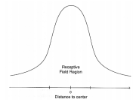
What is a RBF network ?
Particular type of artificial neural network that was first formulated in 1988 by Broomhead and Lowe.
Used in regression , classification problems and time series prediction , and function approximation.
Biologically inspired from neurons with local/ tuned receptive fields of the nervous system.
Example: - Orientation-selective cells in visual cortex
- Somatosensory cells responsive to specific body regions.
- Auditory system selective to small bands of frequencies ..

Slide 4
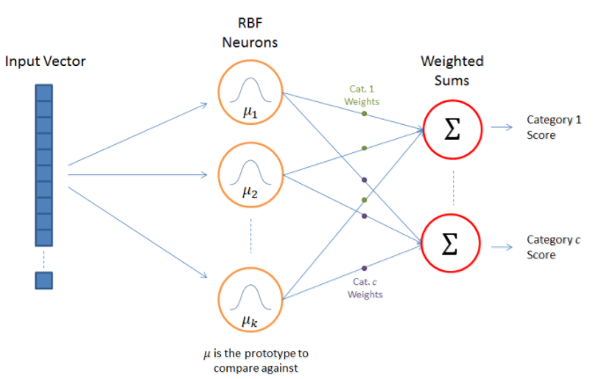
RBFN architecture

Slide 5
An RBFN performs classification by measuring the input’s similarity to examples from the training set.
The basic architecture for a RBF is a 3-layer network.
The first layer is the input layer: n-dimensional vector that you are trying to classify.
The hidden layer is called the “RBF layer” : Each RBFN neuron stores a “prototype” (center), which is just one of the examples from the training set and implement a set of radial basis functions.

Slide 6
The final layer performs a simple weighted summation with a linear output as in an MLP.
- If the RBF network is used for function approximation (matching a real number) then this output is fine.
- If pattern classification is required, then a hard-limiter or sigmoid function could be placed on the output neurons to give 0/1 output values.
The network training is divided into two stages: first the weights from the input to hidden layer are determined ( prototypes), and then the weights from the hidden to output layer.

Slide 7

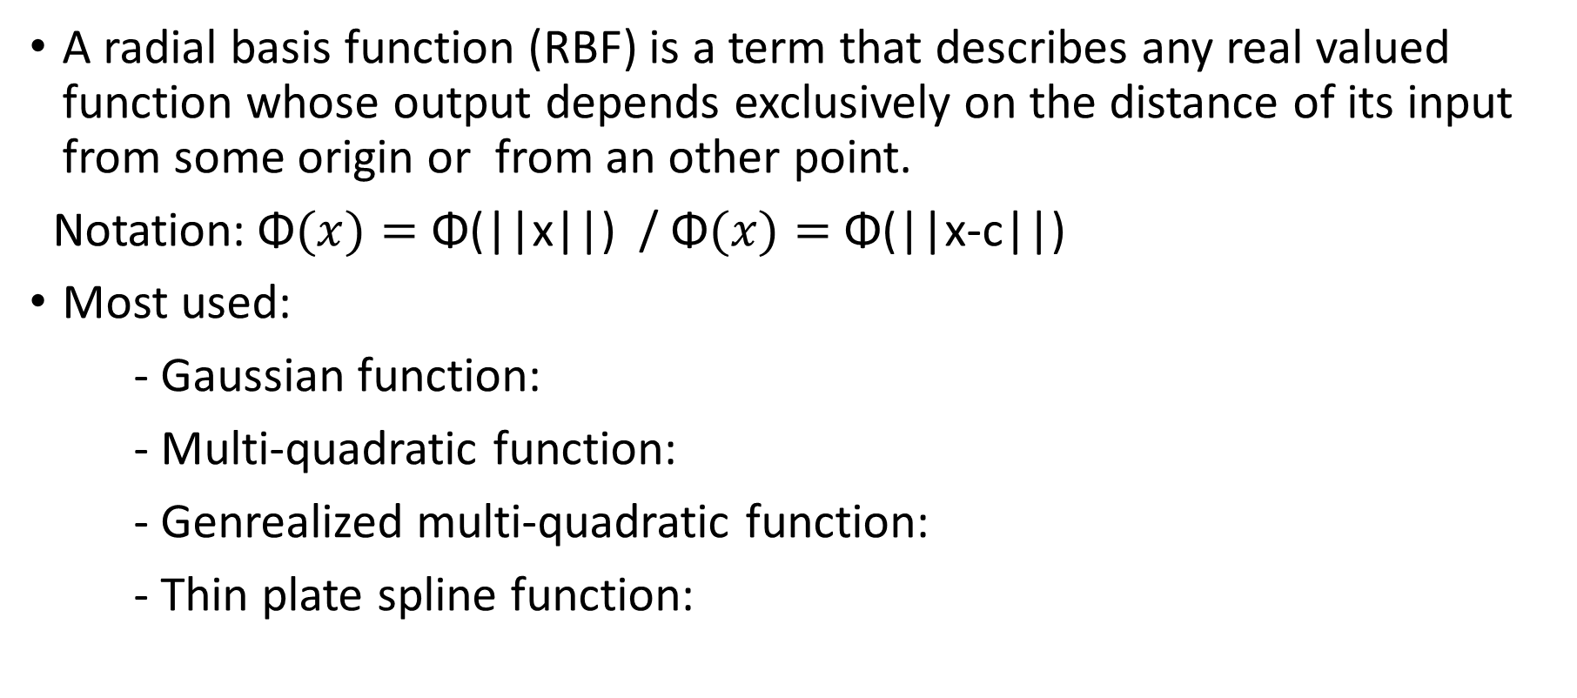
Radial Basis Functions
A radial basis function (RBF) is a term that describes any real valued function whose output depends exclusively on the distance of its input from some origin or from an other point.
Notation:$\text{Φ}(x)=$ Φ(||x||) / Φ$(x)=$ Φ(||x-c||)
Most used:
- Gaussian function:
- Multi-quadratic function:
- Genrealized multi-quadratic function:
- Thin plate spline function:

Slide 8
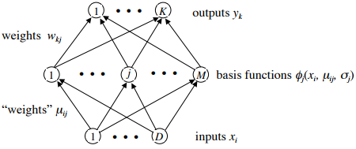


The RBF mapping
N training data points in a D dimensional input space.
Each input vector has a corresponding K dimensional target outout .
Output function:
We shall concentrate on the case of Gaussian basis functions which have centers {µ_{j}} and widths {σ_{j}} :

Slide 9
Training of the RBFN
The following parameters are determined by the training process :
The number of neurons in the hidden layer.
The coordinates of the center of each hidden-layer RBF function.
The radius (spread) of each RBF function in each dimension.
The weights applied to the RBF function outputs as they are passed to the summation layer.

Slide 10
RBFN learning algorithms
Fixed centers selected at random
Hybrid learning process/ clustering based approach
Supervised learning

Slide 11


1- Fixed centers selected at random
Simplest and quickest approach
Select M points at random from the N data points as centers.
Set all the widths to be equal or fixed at
or
( dmax and dave are the maximum and average distance between the chosen centers µ_{j} , to ensure that the individaul RBFs are neither too wide, nor too narrow.)
Compute the output weights.

Slide 12
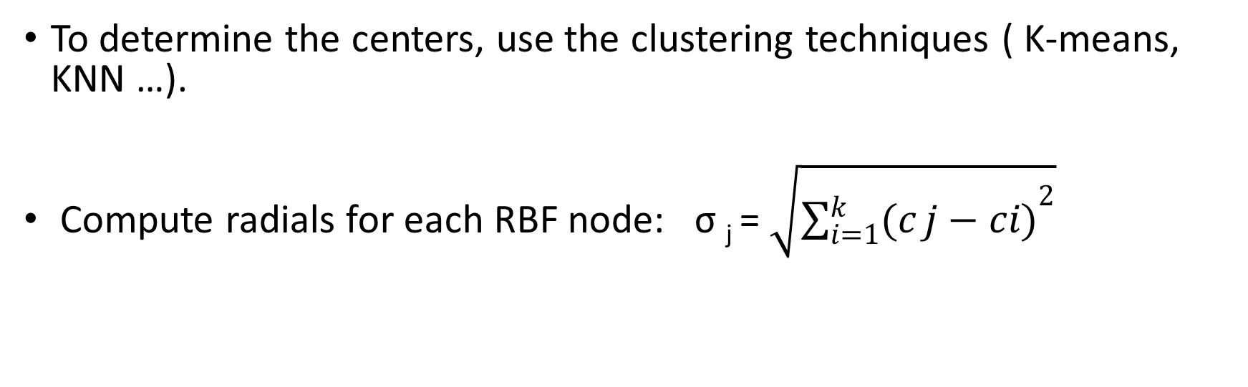
2- Hybrid learning process
To determine the centers, use the clustering techniques ( K-means, KNN …).
Compute radials for each RBF node: σ _{j} = $\sqrt{{\sum_{i=1}^{k}{(c}j−ci)}^{2}}$

Slide 13



Dealing with the output layer
We only have to optimize a single layer linear network.
Define the sum-squared output error:
At the minimum of E the gradients with respect to all the weights w_{ki}

Slide 14
Computing the output weights
Considering: ( W)_{kj}= w_{kj ,} (φ)_{pj}= φ_{pj ,} (T)_{pk}={t_{k}^{p} }
Φ^{t} ( T- Φ W^{t})=0
Formal solution for the weights: W^{t}= (Φ^{t} Φ)⁻¹ Φ^{t} T
Pseudo inverse: Φ^{ψ} = (Φ^{t} Φ)⁻¹ Φ^{t}
In practice, we use SVD ( Singular Value Decomposition) techniques to avoid problems due to possible ill- conditioning of Φ.

Slide 15


3- Supervised learning
Supervised training of RBF parameters may lead to better results than the unsupervised procedures, but the computational costs are usually enormous.
Perform gradient descent on sum squared ouutput error function.
Iteratively update the parameters using:

Slide 16
Comparison: RBFN vs MLP
Differences
- RBF networks are naturally fully connected with a single hidden layers, MLPs can have any number of hidden layers.
- RBFN have the same activation function , MLP’s neurones don’t share necessarily the same activation function.
- RBF: quick training, MLP: slow training.
- MLPs construct global approximations to non-linear input-output mappings with distributed hidden representations, whereas RBF networks tend to use localised non-linearities (Gaussians) at the hidden layer to construct local approximations.
Similarities
Both non-linear feed-forward networks.

